Slide 1

Practical Data Science A1 Part 2: Task 1
Jialun Darren Huang S3755729

Slide 2
Contents
Data Preparation
Data Exploration
Data Analysis

Slide 3
Data Preparation

Slide 4
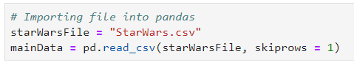
Data Preparation
Reading dataset
Importing dataset to pandas
Skip the first row: skiprows = 1
Notes:
To begin, we import the dataset to pandas.
We have to skip the first row as the .csv file contains the questions in the survey.

Slide 5
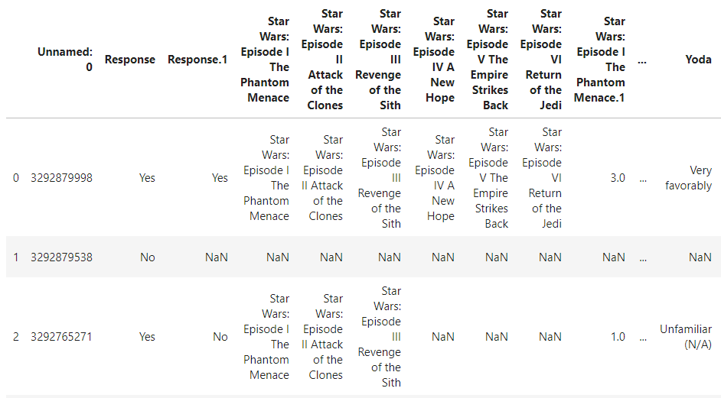
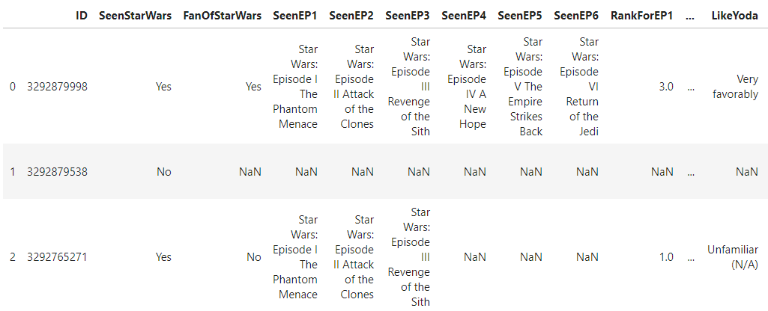
Data Preparation
Reading dataset
Importing dataset to pandas
Change column names
Notes:
I changed the column to shorter but easy to understand names.
This helps me to distinguish each column easily.
Next, we proceed to check for errors for all columns in the data

Slide 6
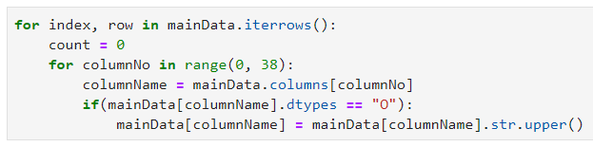

Data Preparation
Upper case all Strings
Set all columns to Upper case
str.upper() function
Notes:
All the data is set to upper case.
We use a for loop to iterate through each row and for all data in each column, we use the str.upper function to upper case all characters.
Numbers will not be affected from this function

Slide 7
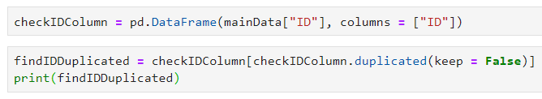
Data Preparation
Checking ID
ID
ID are unique
Find duplicates using duplicated() function
Notes:
Starting with checking the first row, ID.
IDs are unique. There should be no duplicated ID in the dataset.
By using the duplicated function, you can detect if there is any similar ID in the column.
keep = false means that all duplicated instances, including the duplicated instance, will be shown. This can help me figure out which rows are having the same duplicated ID.
Based on the dataset, there is no duplicated ID.

Slide 8
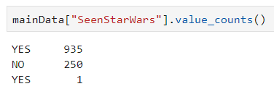
Data Preparation
Have you seen Star Wars?
SeenStarWars
Yes or No responses only
Notes:
For this column, there should only be either a Yes or No answer.
However, there is an extra Yes answer, that is standing out from all the Yeses in the other column.
I assumed that there is a whitespace problem. The respondent may have accidently typed extra spacebars while answering the question.

Slide 9
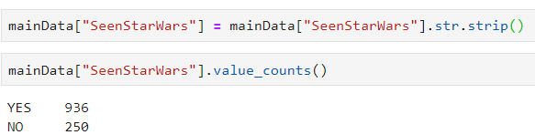
Data Preparation
Have you seen Star Wars?
SeenStarWars
Remove whitespaces with str.strip() function
Notes:
By using str.strip() function, which strips both ends of excessive whitespaces, the issue of a different Yes is resolved.

Slide 10
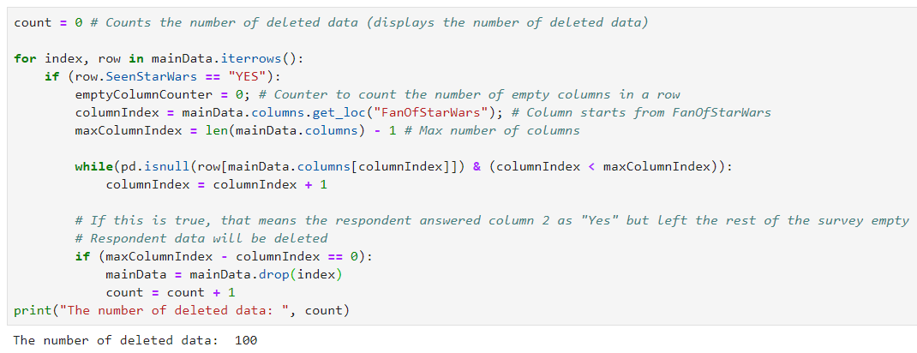

Data Preparation
Have you seen Star Wars?
SeenStarWars
Missing data
Notes:
Another issue is that there are rows with missing data.
Some respondents who have seen Star Wars have the rest of the questions empty.
This could be due to corruption in data or respondents not answering questions, or just someone tampering and deleting data from the file.
It turns out that for such respondents, they do not answer anything else in any other columns.
The code here (point/circle) checks for respondents who have seen Star Wars but have the rest of the questions empty.
The for loop and if statement checks if the respondents have seen Star Wars.
emptyColumnCounter counts the number of questions left empty and increments by 1 whenever a column is empty.
If the number of columns empty is the same as the index of the last column, none of the questions have been answered. The row will be removed.
In the end, 100 data are removed from the dataset.

Slide 11
Data Preparation
Have you seen Star Wars?
SeenStarWars
Rows left = 1186 – 100 = 1086
Data segregation
Yes – 836 rows (Our focus now)
No – 250 rows
Notes:
Initially, there were 1186 rows of data. However, after removing 100 rows of data earlier, there is 1086 rows left.
Also, since respondents who have not seen Star Wars do not continue to the survey, in our data preparation, exploration and modelling, we have to not include them in any of our findings while handing other columns/features
Therefore, we will now focus on the 836 rows, who are respondents that have seen Star Wars.

Slide 12
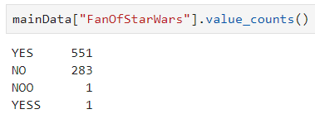
Data Preparation
Are you a fan of Star Wars?
FanOfStarWars
Yes or No responses only
Notes:
Similarly as SeenStarWars, there should only be either a Yes or No answer.
This time, there are 2 incorrectly entered answers by 2 different respondents.
My guess is that the respondents may have accidently clicked an extra letter at the end of the answer.

Slide 13
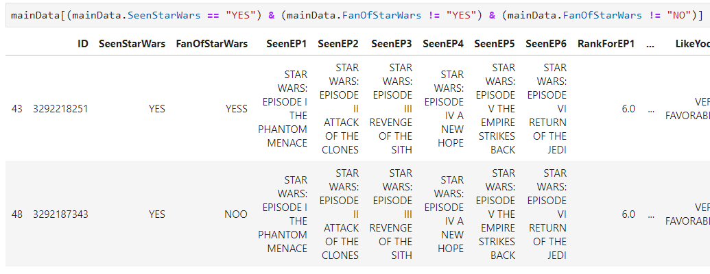
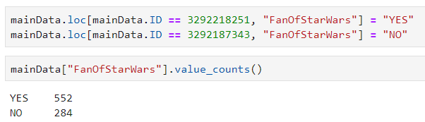
Data Preparation
Are you a fan of Star Wars?
FanOfStarWars
Notes:
Firstly, I search for the respondent who made the error.
With the respondent’s ID, I can change the data manually.

Slide 14
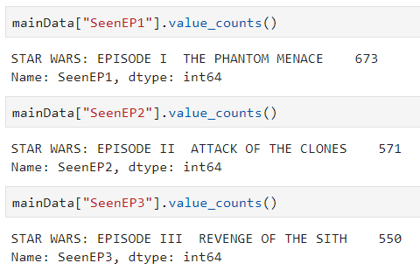
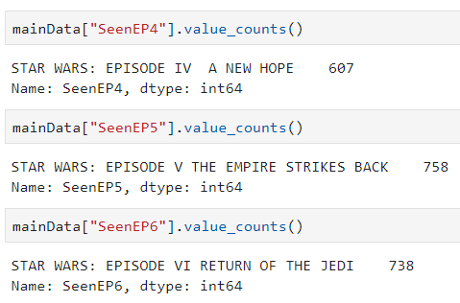
Data Preparation
Have you seen Star Wars Episode I - VI
SeenEP1 - SeenEP6
Notes:
For these columns, I guess the survey is using checkbox, where respondents tick which film they have watched.
However, as there may be data corruption, I checked if there is any wrong spellings in each row and column of these data.

Slide 15
Data Preparation
Please rank Star Wars films in order of preference.
RankForEP1 – RankForEP6
Ranking values – 1.0 2.0 3.0 4.0 5.0 6.0
No duplicates of ranking values in respondent’s answer
Notes:
For these columns, every respondent should have at least indicated 6 different values in each ranking column.
Also, there should not be any duplicated rank for each row.
We will have to check these 2 things

Slide 16
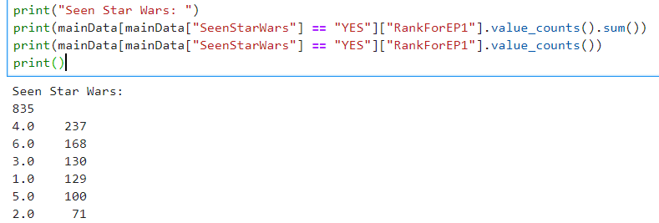
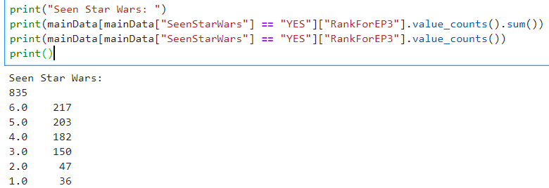
Data Preparation
Please rank Star Wars films in order of preference.
RankForEP1 – RankForEP6
Ranking values
836 ranking values
Notes:
For ranking values, there should be 836 responses, by our 836 respondents.
However, in RankforEP1 & RankforEP3. there is only 835 responses. There is a missing value in each of those column.

Slide 17
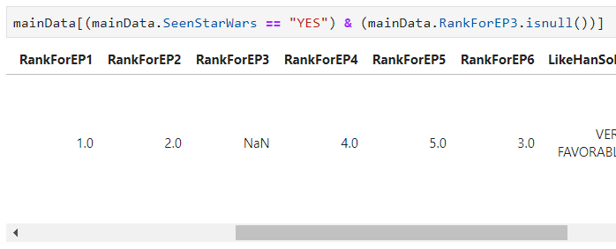

Data Preparation
Please rank Star Wars films in order of preference.
RankForEP1 – RankForEP6
Ranking values
Isnull() function
Notes:
I use isnull() function to check which row are having the empty columns RankEP1 & RankEP3.
We will be using RankforEP3 as the example of how I resolve this error.
Here you can see that in this row, RankForEP3 is NaN. There should be a value inside here.
By using logic, we can see that based on how this respondent ranks the other ranking columns, RankForEP3 can be deduced as 6.0, since 6.0 is the only value left in the ranking values.
RankForEP1 is having the same issue, and can be solved by deduction, based on the values of other ranking columns

Slide 18
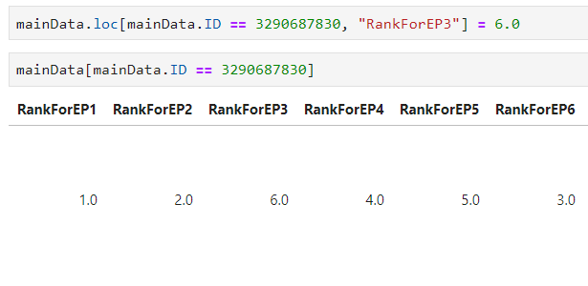
Data Preparation
Please rank Star Wars films in order of preference.
RankForEP1 – RankForEP6
Ranking values
Isnull() function
Notes:
I changed the value manually. This is same for the error in RankForEP1

Slide 19
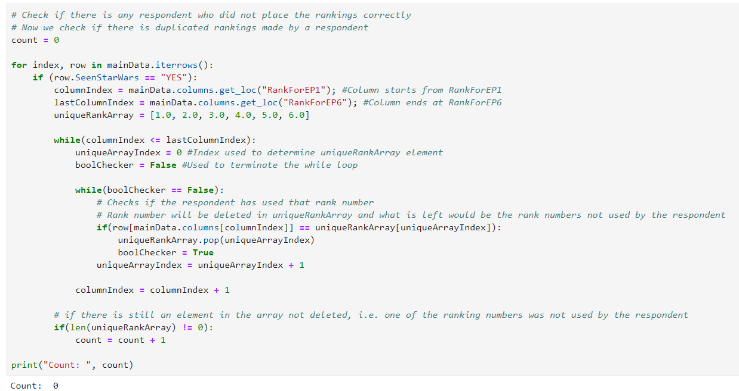
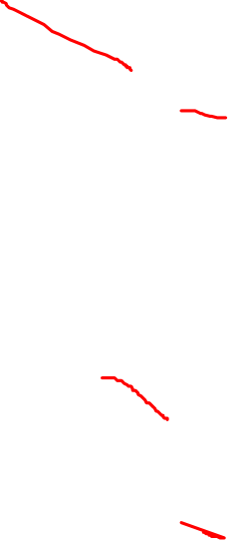
Data Preparation
Please rank Star Wars films in order of preference.
RankForEP1 – RankForEP6
No duplicates of ranking values in respondent’s answer
Notes:
Next, I checked if there is any duplicates.
I used a for loop to cycle through all the rows, focusing on only the ranking columns.
I created an array that hold 1.0 to 6.0 and for every value that the respondent has written in the ranking columns, I removed the same value from the array.
Finally, I counted the size of the array, and if the size is more than 0, this means that one of the values in the array has not been removed. There is a duplicated number.
As there is no way to determine which episode is rank higher or lower, and to treat everything fair and equal, this row will be removed from the dataset.
Thankful, there is no rows with this issue, as we can see from count, displaying 0 rows deleted.

Slide 20
Data Preparation
Please state how much you like each character.
Like<Character Name>
Very Favorably
Somewhat Favorably
Neither Favorably nor Unfavorably
Somewhat Unfavorably
Very Unfavorably
Unfamiliar (N/A)
Notes:
In these columns, I assume the respondents can only pick one of the many options as given.

Slide 21
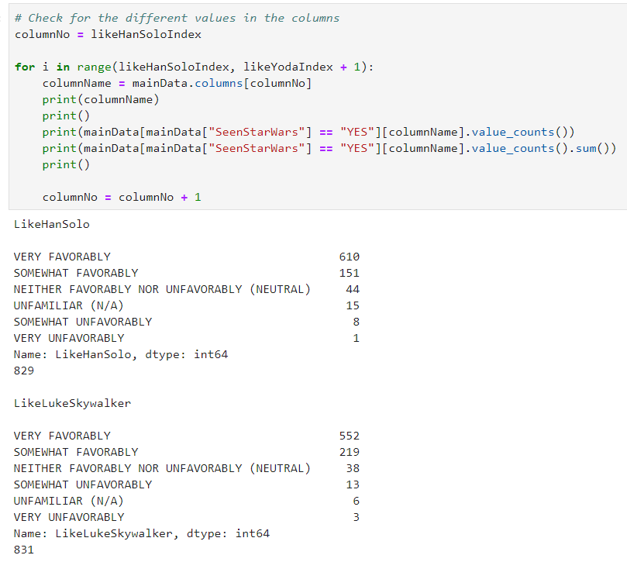
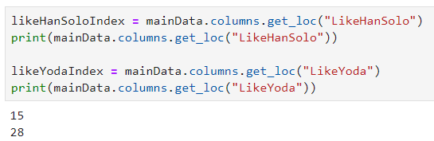
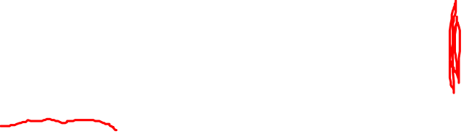
Data Preparation
Please state how much you like each character.
Like<Character Name>
Notes:
I used a for loop, since it is less tedious, rather than writing one column at a time.
I should have done this for the earlier columns, but I am glad I did it in this column, and for the rest.
I use .columns.get_loc() function to get the index of the first column (LikeHanSolo), and the last column (LikeYoda) for these similar questions.
The columns will be checked from LikeHanSolo till LikeYoda.
Here we can see that I firstly display the column name, make some nice spacing, and then display the column’s different values.

Slide 22
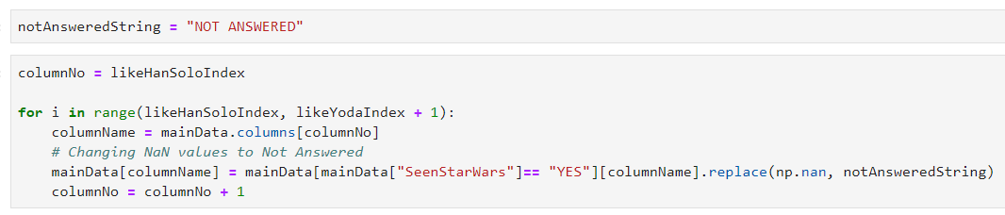
Data Preparation
Please state how much you like each character.
Like<Character Name>
Not Answered
.replace() function
Notes:
Here is where I would like to talk about how I tackle with data that cannot be deduced through logic.
For any data that cannot be deduced obviously or are missing values, NaN, I would change its data to Not Answered.
The reason? Well I think it is unfair to the whole dataset that I make a judgement without 100% concrete evidence.
Therefore, I shall put it as Not Answered, as I still want to keep the row, since it may or has important data in other columns, such as the demographics.
I created a string, notAnsweredString, and this string will be used in the other columns as well.
There were no typo errors but NaN data, that cannot be deduced obviously. Therefore, these data will be set to Not Answered, based on the columns left empty.
I used a for loop and with .replace() function, I replace all NaN to Not Answered

Slide 23
Data Preparation
Please state how much you like each character.
Like<Character Name>
Notes:
With that, all 836 rows are not having any missing values.

Slide 24
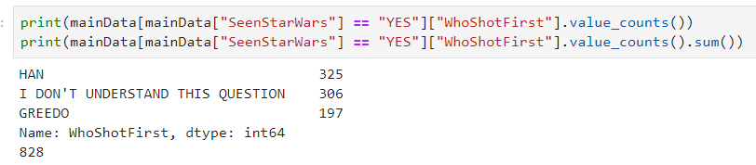
Data Preparation
Which character shot first?
WhoShotFirst
Han
Greedo
I don’t understand this question.
Notes:
Similarly, I used notAnsweredString to change all missing, NaN values to Not Answered.
It is not right to throw all of the missing values to I don’t understand this question, as they might understand the question. Who knows?

Slide 25
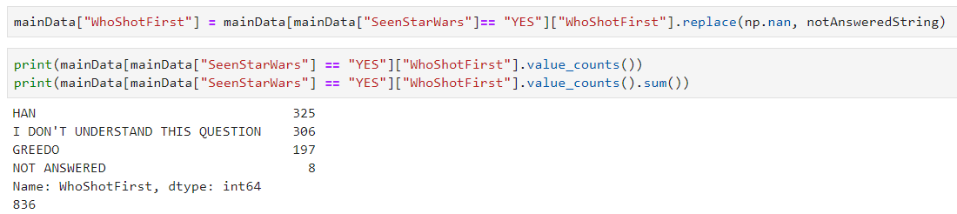
Data Preparation
Which character shot first?
WhoShotFirst
Notes:
Set all missing values to Not Answered

Slide 26
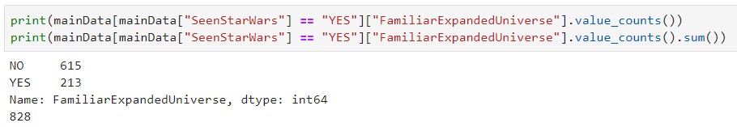
Data Preparation
Familiar with Expanded Universe?
FamiliarExpandedUniverse
Yes or No responses only
Notes:
For this column, there should be only Yes or No responses.
However, based on value counts, there is missing data. These data will be set as Not Answered.
As this question is not the main focus of the survey, I do not think these rows of data should be deleted. You will lose data in other columns of these rows.

Slide 27
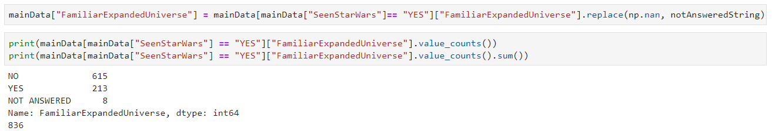
Data Preparation
Familiar with Expanded Universe?
FamiliarExpandedUniverse
Yes or No responses only
Notes:
There are 213 respondents who answered Yes to being familiar with expanded universe. These 213 respondents would have to answer the next column, which is whether if they are a fan or not of Expanded Universe.

Slide 28
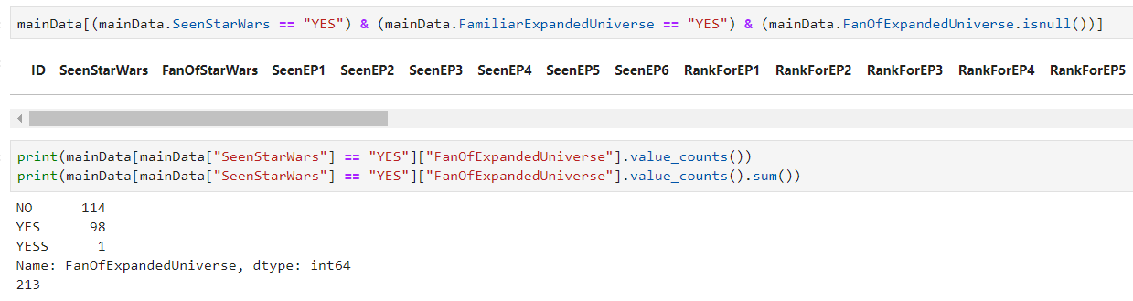
Data Preparation
Fan of Expanded Universe?
FanOfExpandedUniverse
Yes or No responses only
Notes:
Likewise, only Yes or No responses will be accepted.
Here we can see that all respondents who are familiar with expanded universe answered this column.
However, there is one answer that is YES, with an extra S.
We have to change it manually, like what we always do, and I assume that the respondent accidently entered another S at the end, and wanted to answer YES.

Slide 29
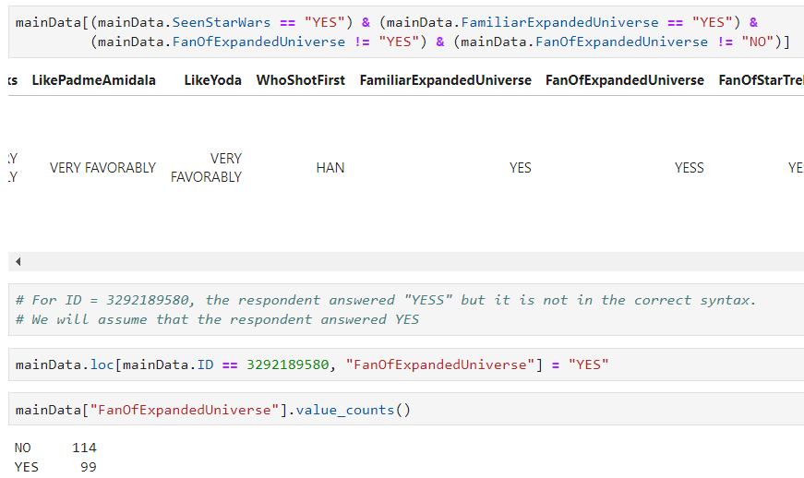
Data Preparation
Fan of Expanded Universe?
FanOfExpandedUniverse
Notes:
Here you can see I found the respondent who made the typo error.
I manually changed it to YES.

Slide 30
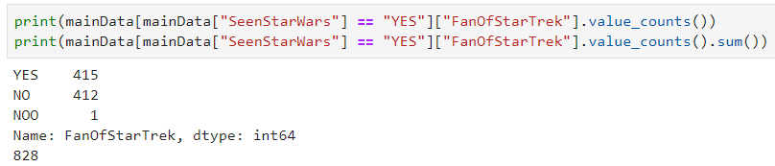
Data Preparation
Fan of Star Trek franchise?
FanOfStarTrek
Yes or No responses only
Notes:
Coming back to the 836 respondents, they should answer whether they are or not a fan of Star Trek, with Yes or No responses.
However, there are 2 issues. Firstly, a respondents answered NOO, with an extra O. I assumed, as always, the respondent wanted to answer NO and accidently typed the last letter again.
Next, there is missing values, and they will be set as Not Answered, as discussed with my reasoning before.

Slide 31
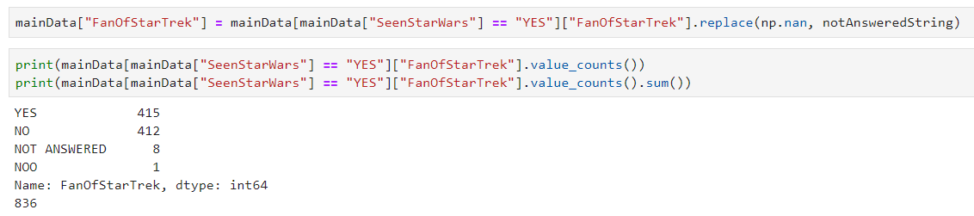
Data Preparation
Fan of Star Trek franchise?
FanOfStarTrek
Notes:
Firstly, I changed all missing values to Not Answered.

Slide 32
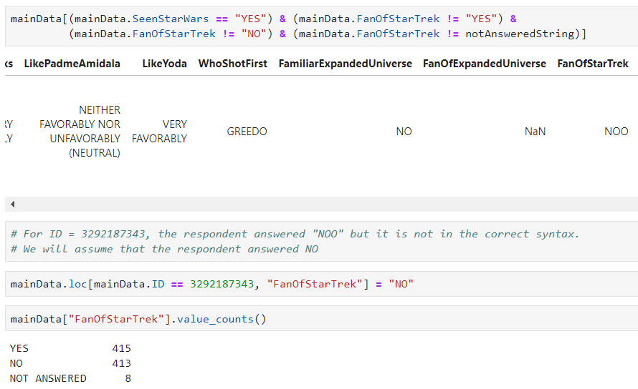
Data Preparation
Fan of Star Trek franchise?
FanOfStarTrek
Notes:
Next, and lastly, I fixed the respondent’s NOO answer manually. Now we have a complete 836 responses in this column.

Slide 33
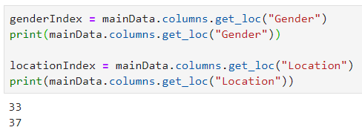
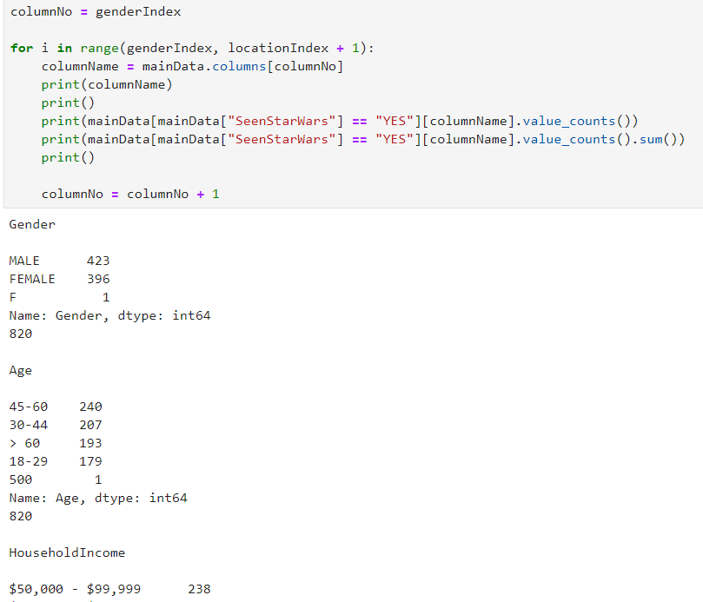
Data Preparation
Respondent’s Demographics
<Demographic> (Gender, Age, HouseholdIncome, Education, Location)
Notes:
At last, we come to the respondent's demographics.
I used the same concept back at how respondents like each character.
For each demographic, I have to check whether they are logical to what the demographic is.
For example, Gender should only be Male or Female, another else is either typo, missing value or unknown, which will be set to Not Answered if necessary.

Slide 34
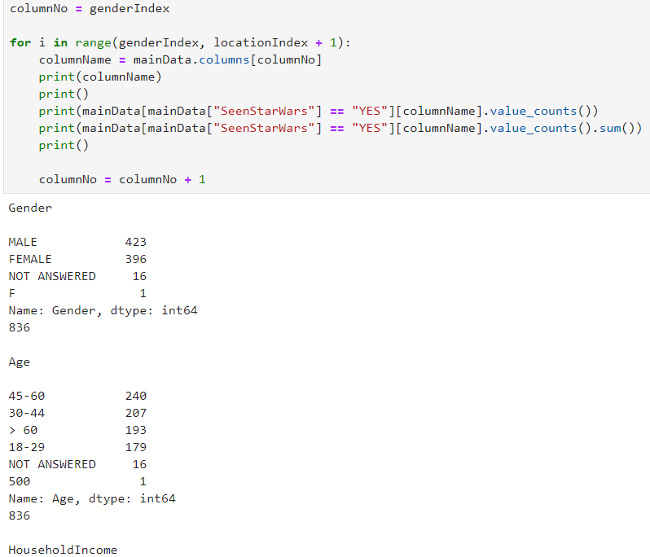
Data Preparation
Respondent’s Demographics
<Demographic> (Gender, Age, HouseholdIncome, Education, Location)
Notes:
To make it simpler to fix typo errors, I fixed all missing values first, setting them to Not Answered.
Now I will go through each demographic to spot for typos or anything that is not what we are looking for, based on how the survey was done.

Slide 35
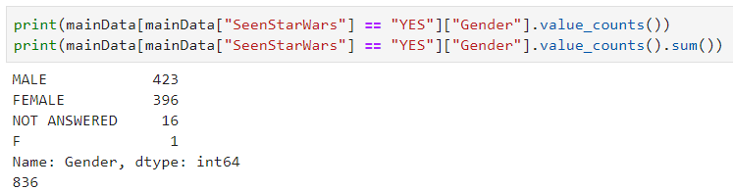
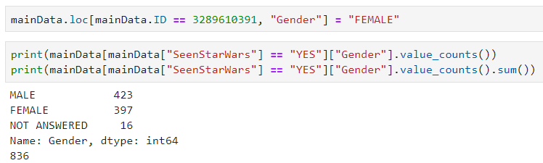
Data Preparation
Respondent’s Demographics
Gender
Notes:
In Gender, we can see that there is a F, which is not what we are looking for. Based on my assumptions, the respondent is a Female and F is a universal term known as Female when used in Gender.
Therefore, I manually change F to Female.

Slide 36
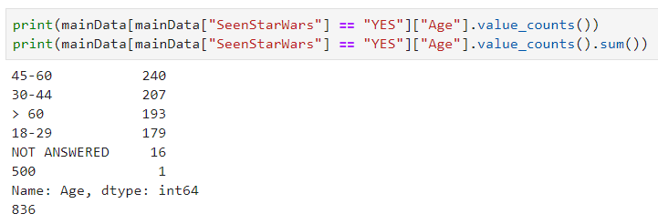
Data Preparation
Respondent’s Demographics
Age
Notes:
Here, age is a tricky one.
In this data, we can see that a respondent entered 500. It is as of now, impossible to live till 500 years old.
Most assumptions can be said that the respondent wanted to entered 50 and typed an extra 0.
However, in my opinion, this assumption is weak as there is no clear evidence that the respondent is 50 years old.
Therefore, to be safe, and to keep the data fair and equal, I set this respondent’s age to Not Answered.

Slide 37
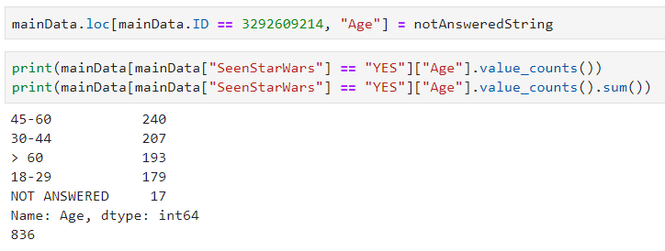
Data Preparation
Respondent’s Demographics
Age
Notes:
Changed this respondent’s age to Not Answered.

Slide 38
Data Preparation
Respondent’s Demographics
No issue in other demographics (HouseholdIncome, Education, Location)
Notes:
There are no abnormalities in the other demographics, after all missing values has been set to Not Answered

Slide 39
End of Data Preparation

Slide 40
Data Exploration

Slide 41
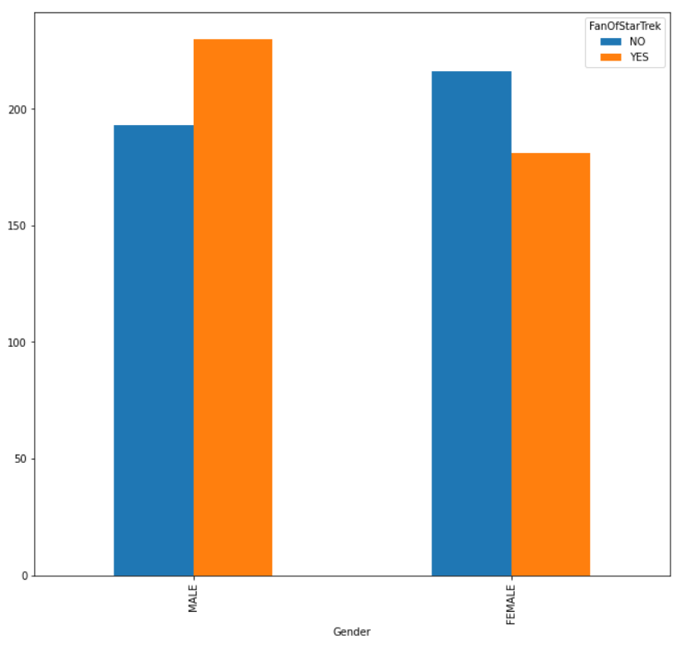
Data Exploration
Use visualization charts
Graph
Notes:
In data exploration, we use visualization charts.
These charts can show a trend or relationship between features and help us give easier and better analysis.
For example, we can use graphs to show the number of respondents in each categories.
Lets take a look at this graph. We can see that males enjoy the Star Trek franchise compared to females.

Slide 42
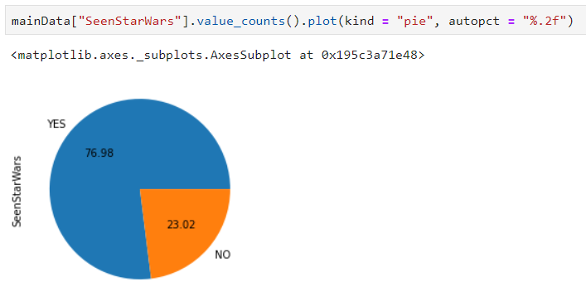
Data Exploration
Use visualization charts
Pie chart
Notes:
We can also use Pie charts.
Pie charts can show percentages of each categories based on the number of respondents
Here we can easily see that about 75%, 3/4 of the respondents have seen Star Wars.

Slide 43
Data Exploration
Target features – Respondent’s demographics
Each of the features against one demographic at a time
Question | Demographic
Have you seen Star Wars? | Gender
 | Age
 | Household Income
 | Education
 | Location
Are you a fan of Star Wars? | Gender
... | ...
Are you a fan of Star Trek Franchise | Location
Notes:
Also, we should focus our data exploration on what we want for our model.
As our target features are based on the demographics, we should focus our data exploration based on the respondents’ demographics.
We analyse and see if there is a relationship in any of the question to the respondents’ demographic.

Slide 44
End of Data Exploration

Slide 45
Data Analysis

Slide 46
Data Analysis
Initial thoughts
Poor survey
Demographics of respondents who have not seen Star Wars are not taken
Marketing – no knowledge to determine which group of people (demographics) they should put more focus to
Respondents age
Most of them are the middle to older generation
May be bias towards
Location not balanced
More surveys to be conducted with locations having lower number in respondents
Can determine which location to focus resources on, e.g. Star Wars convention center
Notes:
Before I begin, I would like to say that in my opinion, this survey is not well made. For respondents who have not seen Star Wars, no personal information or demographic is taken.
We only know that slightly more than 75% have at least seen a Star Wars film, but not know the demographic of the 25% who have not seen Star Wars.
This is bad as for example, age group.
Since we do not know the age group, in terms of marketing, we do not know which age group we should priortise. We do not know whether we should create more Star Wars children toys to attract the young generation or create more practical things like T-Shirt or model kits to attract the middle and older generations
Another thing I found is that most of the respondents are towards the older generation.
There may be a bias in the data towards them. One example is the ranking of movies.
We can see that most of them favour the older movies, than the newer ones.
The locations of respondents are also not balanced. Therefore, there may be bias towards locations with respondents.
What we can do is to conduct more surveys at locations that are lower in respondents, so that they can match the numbers with the locations with higher in respondents.
Location to me, is an important feature as for example, it can tell where should a Star Wars convention center be built, based on the percentage of respondents and the public who are fans of Star Wars.

Slide 47
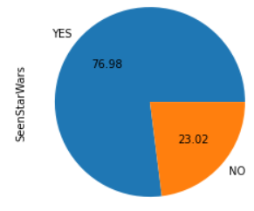
Data Analysis
Have you seen Star Wars?
About 75% have seen Star Wars
Yes | No
836 (76.98%) | 250 (23.02%)
Notes:
The following will be an overall analysis based on all or respondent who have seen Star Wars. I will also try and base my analysis and assumptions to what I believe would be the marketing team, as they would greatly benefit from what the public thinks about Star Wars.
As seen earlier, about 75% (slightly higher) have seen Star Wars.

Slide 48
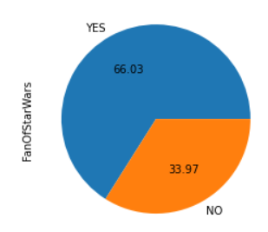
Data Analysis
Are you fans of Star Wars?
66% are fans of Star Wars
Yes | No
552 (66.03%) | 284 (33.97%)
Notes:
66% of the 75% who have seen Star Wars, are fans of Star Wars

Slide 49
Data Analysis
Which episodes have you watched?
Percentage is out of respondents who seen Star Wars (836)
Episode | Number of respondents who watched
Star Wars Episode 1 | 423 (50.10%)
Star Wars Episode 2 | 321 (38.40%)
Star Wars Episode 3 | 300 (35.89%)
Star Wars Episode 4 | 357 (42.70%)
Star Wars Episode 5 | 508 (60.77%)
Star Wars Episode 6 | 488 (58.37%)
Notes:
Here we can see that Episode 5 is the most watched episode, with episode 3 being the least watched. The percentages are out of all the 836 respondents.

Slide 50
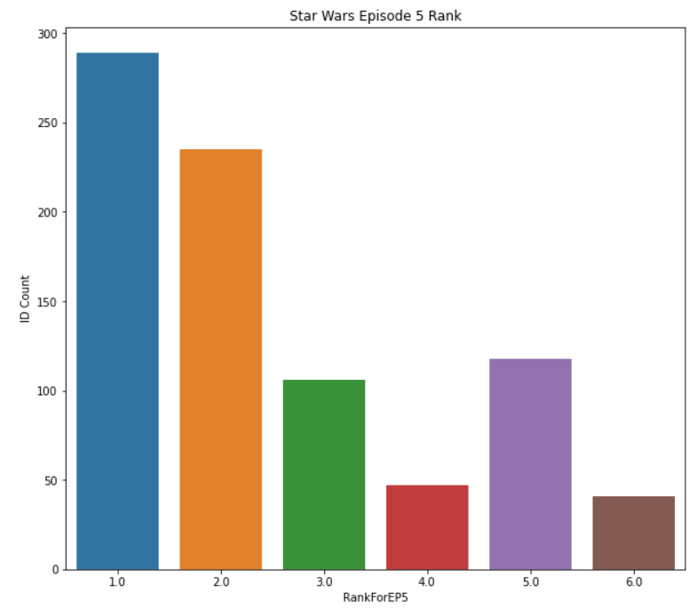
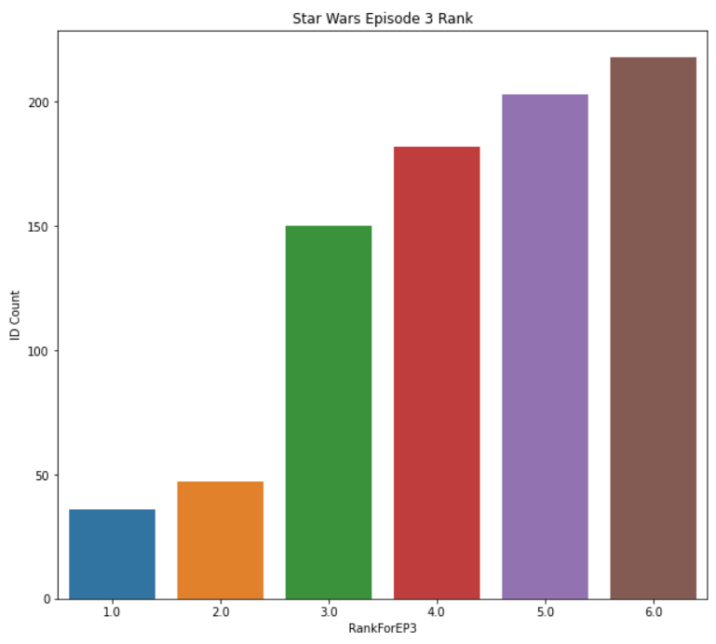
Data Analysis
Episode – Most popular & Least popular (based on rank)
Star Wars Episode V most popular
Star Wars Episode III least popular
Notes:
Based on ranking, Star Wars Episode V was the most popular, while Episode III is the least popular.
Also, the older episodes are more popular, while the newer episodes are less popular.
This can be seen in the previous slide based on the number of people who watch each episodes
Marketing should focus more resources on the older episodes.
Even if the current focus is on the newer episodes, there should still be some resources put on the older episodes.

Slide 51
Data Analysis
Liking Characters
Liked | Average | Disliked
Han Solo | Emperor Palpatine | Jar Jar Binks
Luke Skywalker | Lando Calrissian
Princess Leia Organa | Boba Fett
Obi Wan Kenobi | Padme Amidala
C3P0
R2D2
Yoda
Anakin Skywalker/Darth Vader
Notes:
This is a general table of what respondents, from all demographics feel for each character.
Jar Jar Binks is the most disliked character.
Since this is the case, little to no marketing resources should be reserved to Jar Jar Binks as it may shun away Star Wars fans.
Most respondents like Han Solo, Luke, Princess Leia, Obi Wan, C3P0, R2D2 and Yoda.
Anakin and Darth Vader are also liked too but with slight mixed feelings
There is a mixed feelings for Emperor Palpatine, Lando Calrissian, Boba Fett, Padme.
One analysis is that the characters that are averagely liked usually have lesser screen time than those being liked a lot.
As for lesser screen time characters, there should be lesser marketing focus on them.
However, we still have to take note that all characters, liked or disliked, are still important characters in the Star Wars Series.

Slide 52
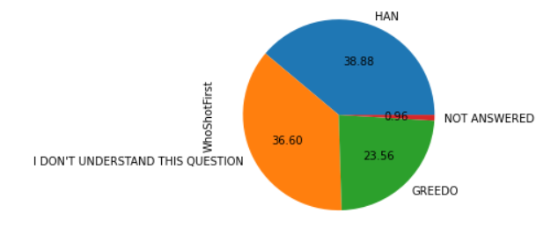
Data Analysis
Who shot first?
Han shot first
Unsure of question
Film vs Book
Han shot first | Greedo shot first | Unsure of question | Not Answered*
325 (38.88%) | 197 (23.56%) | 306 (36.60%) | 8 (0.96%)
Notes:
Not Answered is a column created by me.
While most people agree that Han shot first, there is about a third of the respondents who do not understand this question.
This means that not everyone are familiar with this controversial change in scene in the film as compared to the book.
I can assume that there is a huge group of people who have seen Star Wars in films but not the books.

Slide 53
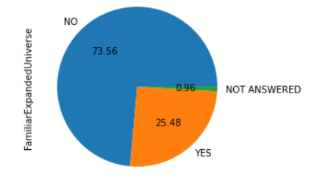
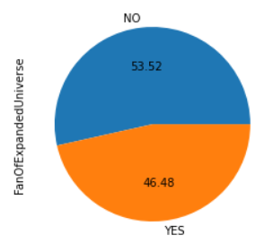
Data Analysis
Expanded Universe
Expanded Universe is not popular
Best to stick with what everyone knows, Star Wars Episodes I - VI
Familiar with Expanded Universe?
Yes | No | Not Answered*
213 (25.48%) | 615 (73.56%) | 8 (0.96%)
Fan of Expanded Universe?
Yes | No
99 (46.48%) | 114 (53.52%)
Notes:
Here we can see that the Expanded Universe is not very popular.
Not many respondents knew about it and for those who know, there is a mixed feelings on whether they are fans of the Expanded Universe.
This means that the marketing team should not focus too much emphasise on the Star Wars Expanded Universe, and go back to what the public knows – the Episodes I to VI

Slide 54
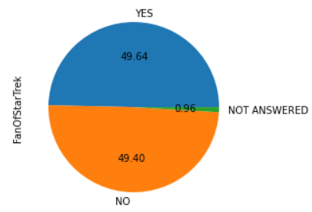
Data Analysis
Star Trek franchise
Star Trek popularity - average
Yes | No | Not Answered*
415 (49.64%) | 413 (49.40%) | 8 (0.96%)
Notes:
Likewise, the Star Trek franchise seems to be doing averagely, as the Yes and No are around 50%
Honestly, I can only assume that this question is out there to know if people are familiar with Star Trek and enjoy watching “Space” theme films, as this is the same theme for Star Wars.
I do not think other than this, there can be much analysis from this question.

Slide 55
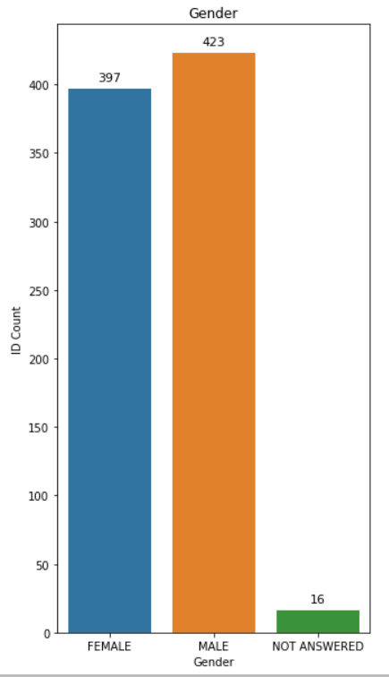


Data Analysis
Respondent Demographics
Notes:
Now we come to the demographics.
Male and Female, mostly the same.
Age, as we talked before, most of them are the older generations
Household income, most of them are in the range of 50k to 100k.
Just like age, we can see that there is inconsistencies in household income. However, there is no way to know the respondent’s age, household income and education just by looking at them as a person, without asking them.
Therefore, even though there may be biases in the data from these demographics, there is nothing much we can do.

Slide 56

Data Analysis
Respondent Demographics
Notes:
Said as before, education is inbalance, but there is no way to know the education of someone from a far.

Slide 57

Data Analysis
Respondent Demographics
Notes:
As said before in the beginning of the analysis, the locations that have low respondents should have more surveys.

Slide 58
Data Analysis
Final thoughts
More analysis?
Notes:
Finally, coming to the end. I would like to say that more analysis can be done, but I do not have the time frame, and have already exceeded the maximum time limit.
However, I believe and hope that I have gone through the more important analysis for this data.

Slide 59
End
Notes:
We have come to the end of the presentation.
I would like to apologise for the extra time you guys have to put in in my presentation.
However, I would like to also thank you for staying throughout the presentation.
Thank you.

